Slide 1
An Active Prosthetic Device
Touch Base
Aseel Yousef
Lihua Diao
Xiaohan Liu
Ethan Gage

Slide 2
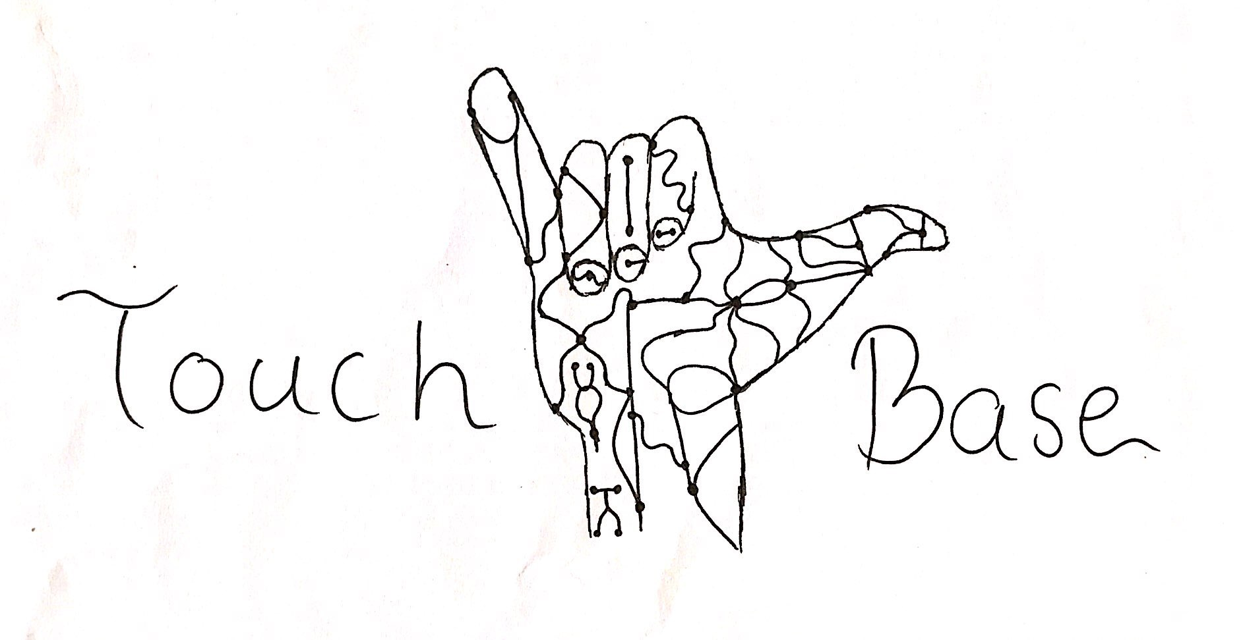
Introduction
Mentor:
  Dr. Winfree
Collaboration with an ME team
Enhancing a prosthetic arm
Aseel

Slide 3
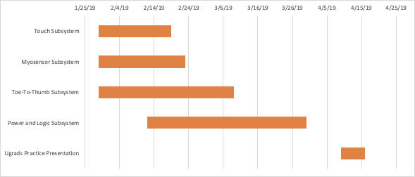
Schedule Overview
Extra time in each
Subsystem for float
Buffer between last
Subsystem and
Final Presentation
Ethan

Slide 4
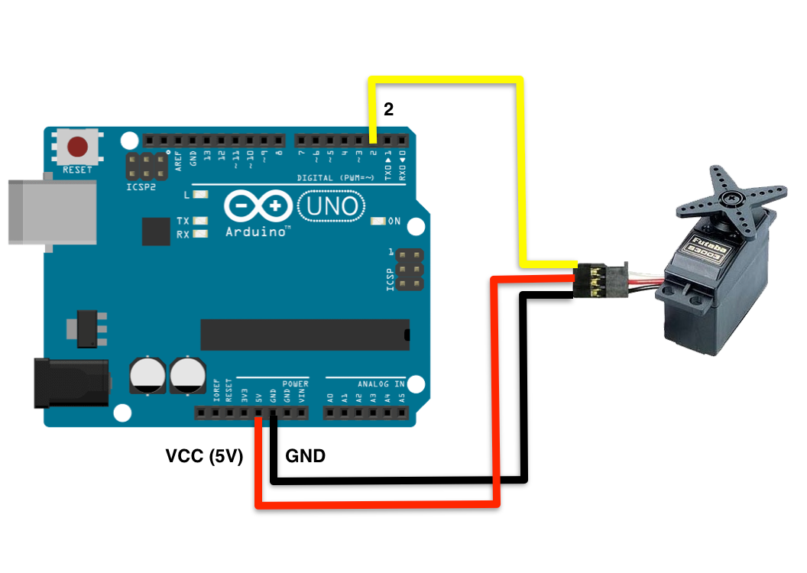
Subsystem 1: Touch
Pressure sensor
  Pressure Sensor - > Arduino -> Servos
Servo motor control
  Constricting bands indicating a firm grip
  Expanding bands indicating a loose grip
This needs to be completed before Myosensor
and logic/power subsystems
Aseel

Slide 5
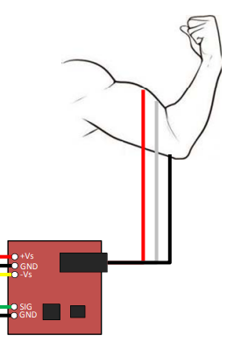
Subsystem 2: MyoSensor
Sensor to read Muscle activation
  Muscle Sensor - > Arduino -> Servos
  Similar Servo control as Touch subsystem
Will use Touch subsystem for feedback
  System will know to stop motors when there's
  Sufficient resistance on those sensors.
  Touch system needs to be completed
  To implement this
Needs to be completed before Logic/Power
can be completed.
Ethan

Slide 6
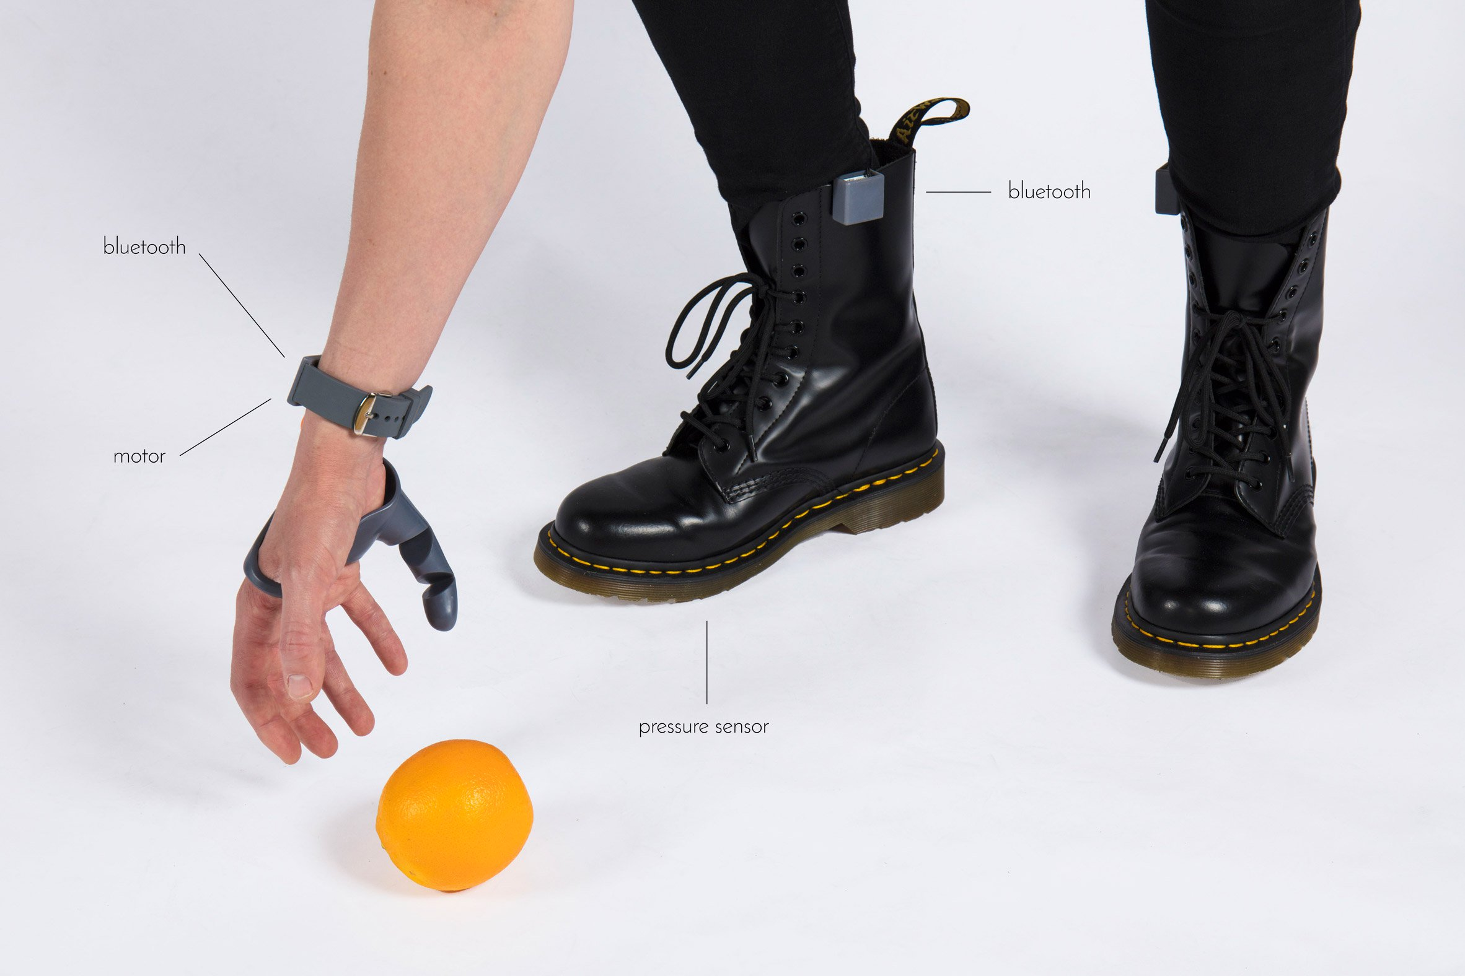
Subsystem 3:Toe-To-Thumb
Pressure sensor to read analog signal data
  Transfer: Sensor - > Arduino -> XBEE transfer
  Receive: XBEE receiver-> Arduino -> servo
Will need to be able to override
Myosensor Subsystem with logic
control
Bluetooth
Bluetooth
motor
pressure
sensor
The Third Thumb Project
-Dani Clode Design
Lihua

Slide 7
Subsystem 4: Power and Logic
Quick swap battery pack
  A heavier, more powerful supply will be powering the motors, while the Arduino will be powered by a lighter, less powerful power source.
Arduino
  Integrate all the subsystems onto one Arduino board.
Xiaohan
Notes:
For the power part, When we finished all the tasks above, we can determine how much power we need. And for the logic part, we will integrate all the subsystems with one arduino.

Slide 8
Closing
Critical Path:
  Subsystem 1 needs to be completed before subsystem 2, which needs to be completed before subsystem 3
  All subsystems (1-3) needs to be completed before subsystem 4 can be completed
Each subsystem has extra time alloted for parts to be ordered
We have a week buffer period between end of subsystem 4 and final presentation to allow for overflow.
Xiaohan
Notes:
To sum up, the 4 subsystems are completed in order. And each subsystems has extra time alloted for parts to be ordered. In order to complete the whole project in time,

Slide 9
Thank You

